Slide 1
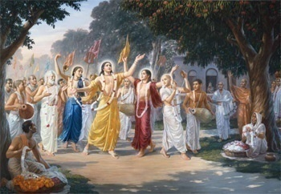
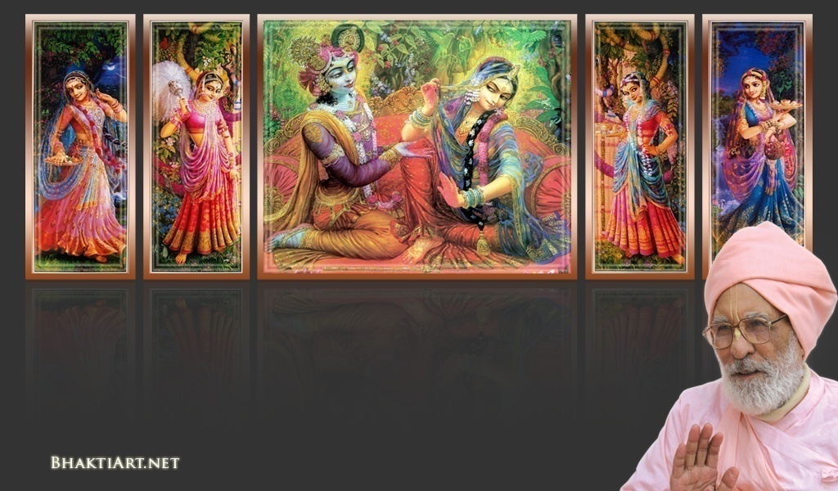
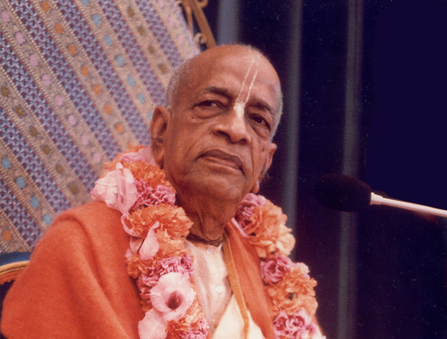
Sri Krsna Caitanya Prabhu Nityananda
Sri Advaita Gadadara Srivasadi
Gaura Bhakta Vrinda
NC-15-P16
0300
Apr 25, 2014
Hare Krsna Hare Krsna
Krsna Krsna Hare Hare
Hare Rama Hare Rama
Rama Rama Hare Hare
Gokul Bhajan & Vedic Studies
North Carolina, USA
Notes:
Om Ajnana timirandhasya, jnananjana salakaya
Caksur unmimiltam yena, tasmai sri gurave namah
Namah om vishnu padaya, radhikayah priyatmane
Sri-srimad bhaktivedanta, narayana iti namine
Sri krishna lila kathane sudaksham
Audarya-madhurya gunais ca yuktam
Varam varenyam purusham mahantam
Narayanam tvam sirasa namami
He krishna karuna sindho, dina bandho jagat pate
Gopesha gopika kanta, radha kanta namo ‘stu te
tapta kancana gaurangi, radhe vrindavaneshvari
vrsabhanu sute devi, pranamami hari priye
bhajami radham aravinda netram
smarami radham madhurasmi-tasyam
vadami radham karuna bharardram
tato mam anyasti gatir na kapi
bhaktya vihina aparadha lakshai
ksiptas ca kamadi taranga madhye
krpamayi tvam saranam prapanna
vrinde numas te caranara vindam
--------------------------
First of all, I pay my koti dandavat pranams to my diksha guru Om vishnupada rupanuga acharya Sri Sri Bhakti Vedanta Narayana Goswami maharaja.
My dandavat pranams to Sri Sri Bhakti Vedanta Swami Prabhupada, and guru varga.
My humble pranams at the lotus feet of all assembled devotees, vaishnavas and vaishnavis..

Slide 2
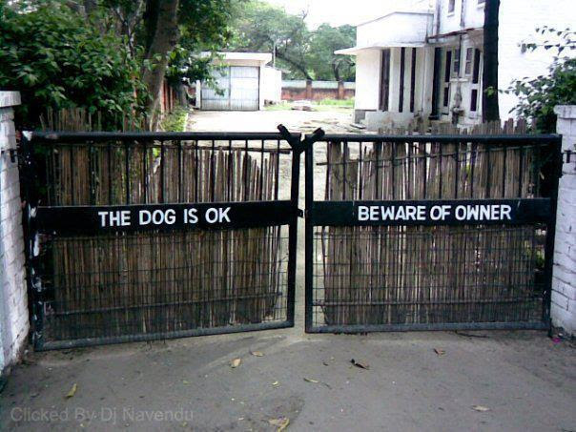
BEWARE OF DOG!
Dr. Jnanananda Ph.D
Notes:
Last 2 episodes, we covered..
Siddhas – Their goal (power) – So, Krishna throws the Dog Bone of Ashta Siddhis.
Karmis and Karma Yogis – Their Goal is for Bliss and enjoy in heavenly planets
All their goals we compared to dog bones!
Today we will cover the 3rd aspect – the Jnanis..
They are very different, they are much higher..
From Dharmi -> Karma Yogi → Jnana Yogi.
But today, I am going to cover a different perspective of this!
(Now ONLY click the mouse)

Slide 3
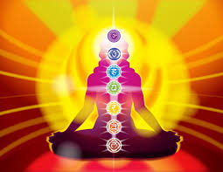
Jnana-
Knowledge!
Notes:
Everyone says ‘Knowledge is the most powerful thing”.
Knowledge is POWER.
But what is that Jnana?
We will explore it today..

Slide 4
Notes:
Watch this video..
In this world, which is a dust particle compared to the creation,
we do not know many things even around us.

Slide 5
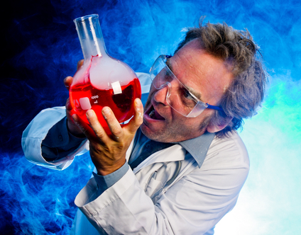
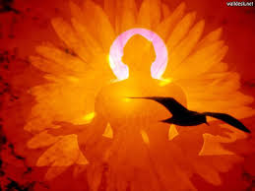
There are 2 kinds of knowledge..
Material Knowledge
Spiritual Knowledge
Notes:
Material worlds are temporary
The laws are different in different universes.
All are gone when the universe is annihilated at Maha Pralaya.

Slide 6
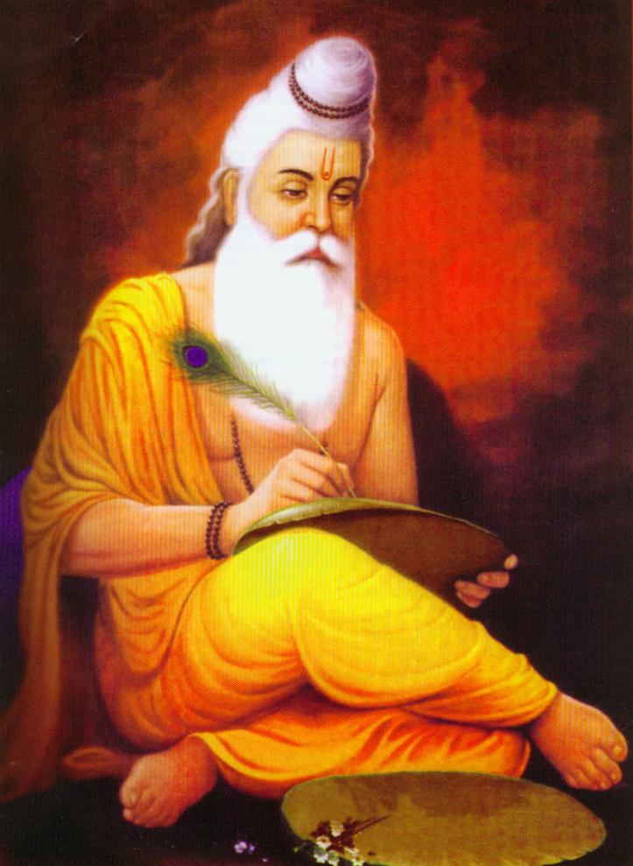
But, Spiritual Knowledge is eternal, does not change

Slide 7
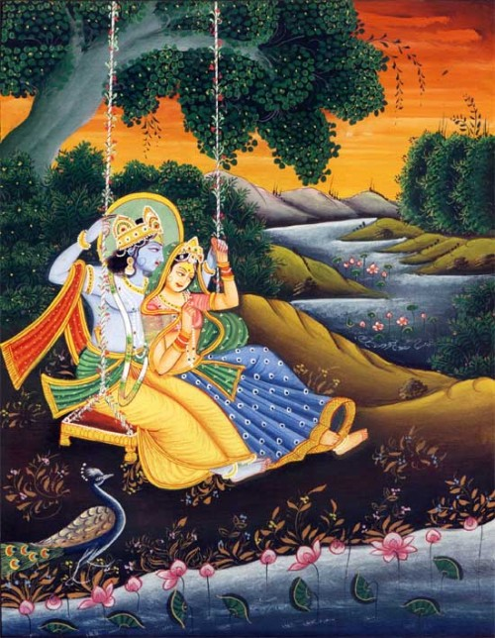
Jaya Rādha Mādhava
Jaya Kunja Vihārī
Jaya Gopī Jana Vallabha
Jaya Giri Vara Dhārī ... (Jaya)
Yaśodā Nandana Vraja Jana Ranjana
Yamunā tīra Vana Cāri ... (Jaya)
[ Hare Krishna Hare Krishna
Krishna Krishna Hare Hare
Hare Rāma Hare Rāma
Rāma Rāma Hare Hare ]

Slide 8
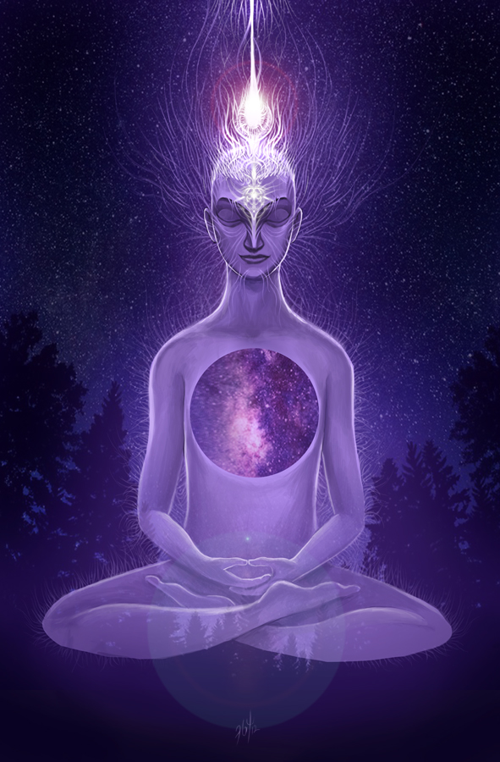
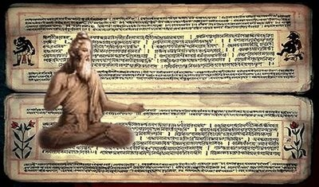
Unbound by Jnana!
Notes:
Last time, we covered: Bound By Karma
This time: we cover: Unbound by Jnana
Jnana means knowledge

Slide 9
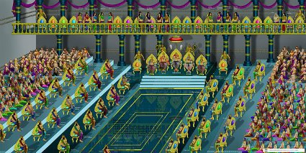
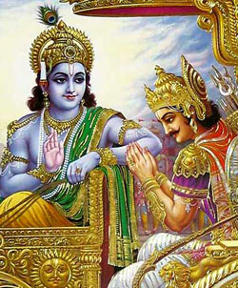
How Superior is Material Knowledge (Yantra Jnana) ?
Notes:
Mayavan was a daemon..
He was the master in manipulating the material World.
He was master making sophisticated machine (Yantra Jnana)!
Once Mayavan was helped by Arjuna and Mayavan won the war..
As remuneration, Mayavan offered Arjuna to give all the Material Knowledge including all Yantra Jnana.
Krishna seriously advised Arjuna NOT to learn that knowledge.
He also said,”In kali Yuga this inferior knowledge will be used everywhere. Do NOT take it.. Run away from it”
So, Arjuna followed Krishna and did not take Yantra Jnana .
The computers, ipads, iphones, atomic bombs, nuclear weapons, all are examples of Yantra Jnana.
As long as it is NOT used for Krishna, these are very bad.

Slide 10
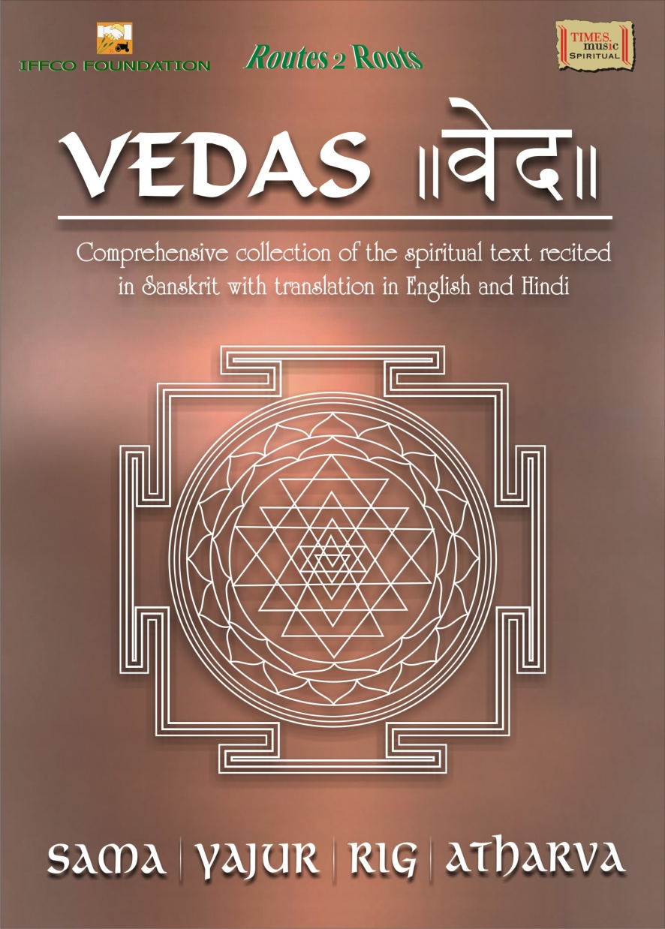
What are Vedas?
What do they teach?
90% Material Knowledge
10% Spiritual Knowledge
Real Spiritual knowledge is beyond it.. VEDANTA..
Notes:
Veda means knowledge..
What kind of knowledge?
Both material and spiritual.
Material knowledge involves our world, our body, mind and senses.. Limited
Spiritual knowledge involves soul, paramatma, brahman, bhagavan, and so on.. Unlimited

Slide 11
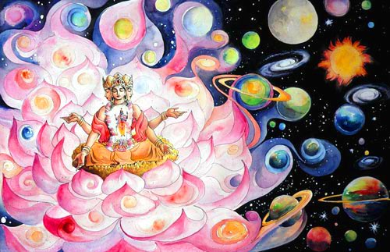
Material creation is temporary. It is also per Brahma’s power..
Notes:
Every Brahma has unique power.
Our Brahma has 4 heads representing his level of power.
There are unlimited Brahmas – one per each Brahmanda.
Many Brahmas have thousands and millions of heads – the level of power.

Slide 12
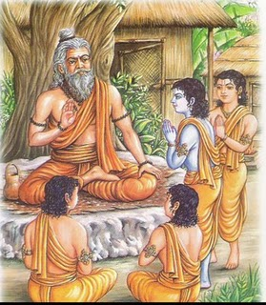
Ajnana vs Jnana
Notes:
There are two kinds of vastus (things) – Spiritual and Material.
Only spiritual entities like souls have consciousness.
Because of consciousness comes freedom.
So, we have freedom to be ignorant, or in knowledge.
Ajnana is dark , ignorance
Jnana is light, knowledge
Our original identity is light, but due to being away from Lord to enjoy ourselves, we developed ignorance.

Slide 13
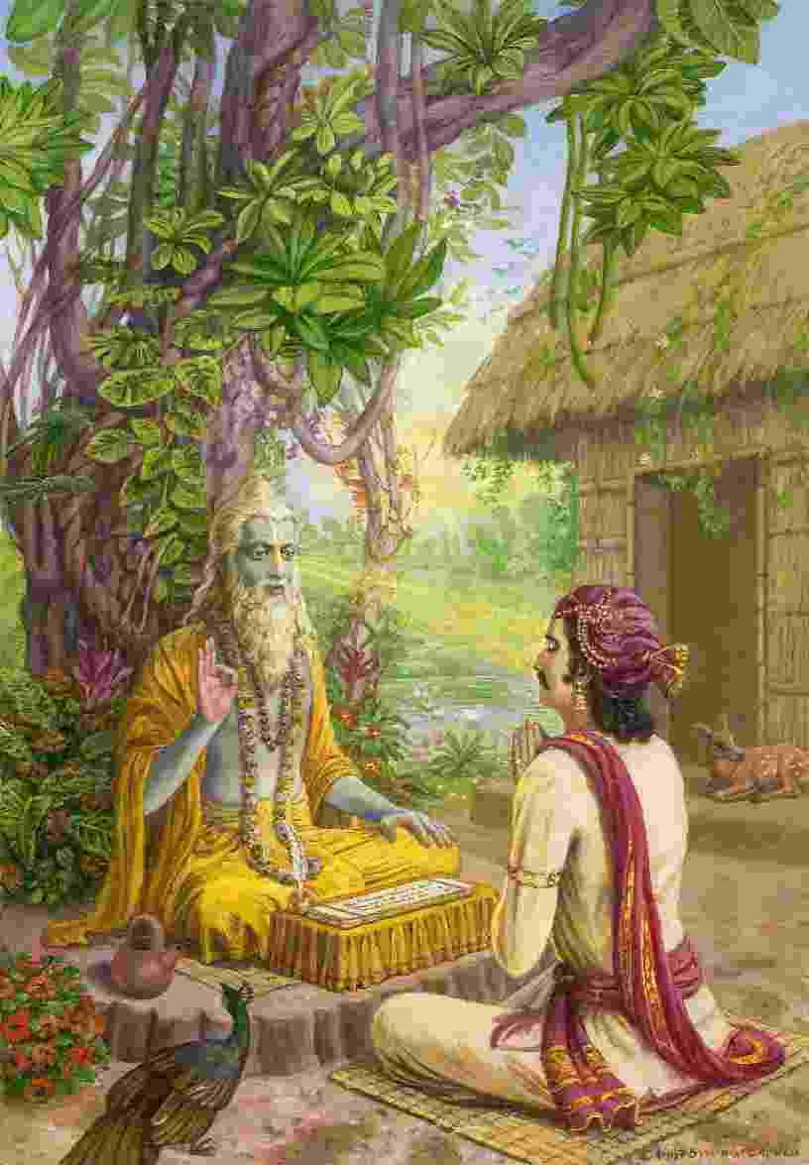
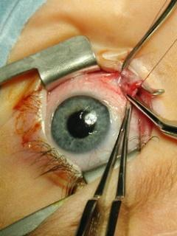
Om Ajnana timirandhasya,
jnananjana salakaya
Caksur unmimiltam yena,
tasmai sri gurave namah
Notes:
We pray to Gurudeva, to get back to the light..
We cannot operate our own eyes – we need a surgeon who can do it.
Gurudeva is that surgeon.!
He removes our ignorance.
He brings the torch of light, and opens our eyes.
When light comes, darkness automatically goes away.
[In science there is no entity called dark, it is defined as lack of light.
So, to remove darkness, we cannot use buckets to transfer.
You bring light and darkness goes away!]

Slide 14
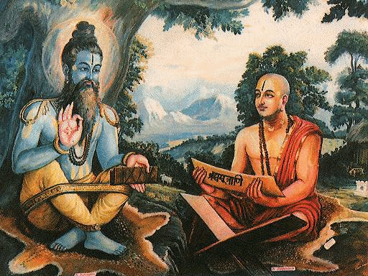
That knowledge (Vidya) never changes..
It is eternal & permanent
Notes:
The Jnana mentioned in the sloka is actually VIDYA.
That knowledge never changes..
It is eternal.
Given by elevated saints and bhaktas.

Slide 15
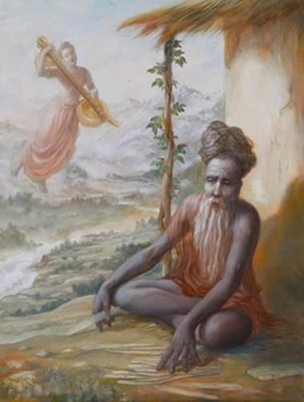
Knowledge is acquired in TWO ways..
(1) ASCENDING
(2) DESCENDING
Notes:
Jnana also means anything that we know.
Two ways of getting knowledge:
By our own endeavor (Ascending)
Receiving from others (Descending)
Eg:
A child touches on the fire and learns that it is hot.
Mother tells the child who is the father

Slide 16
Even material knowledge can’t be acquired fully by ASCENDING process
Notes:
How many of you learned ABCD by yourselves?
They all came by dissension.
The only thing we learned ourselves is:
1) How to CRY for anything

Slide 17
ASCENDING
Not Perfect
By Experiments
Our imperfect senses
Problem with learning by Ascending
Notes:
Not Perfect
By Experiments
Our imperfect senses

Slide 18
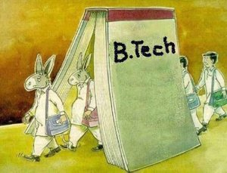
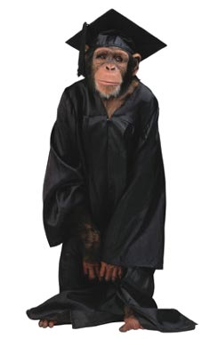
Material knowledge is useful only for living. After we die, it is useless..
Notes:
We study so many things:
Science
Arts
Technology
Economics
Politics
Astronomy
And so on… too much to learn
But what use are they?
They are useful only to make our life comfortable until we die
After that, it is all a waste
So, Material knowledge is useful only for living. After we die, it is useless..

Slide 19
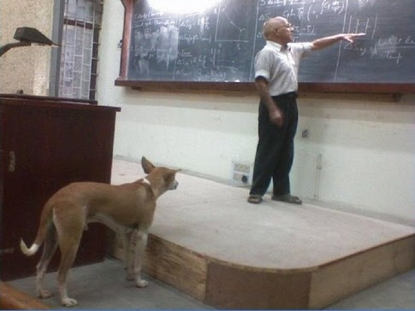
Our material knowledge ONLY makes dogs and monkeys
Notes:
Our material knowledge ONLY makes dogs and monkeys

Slide 20
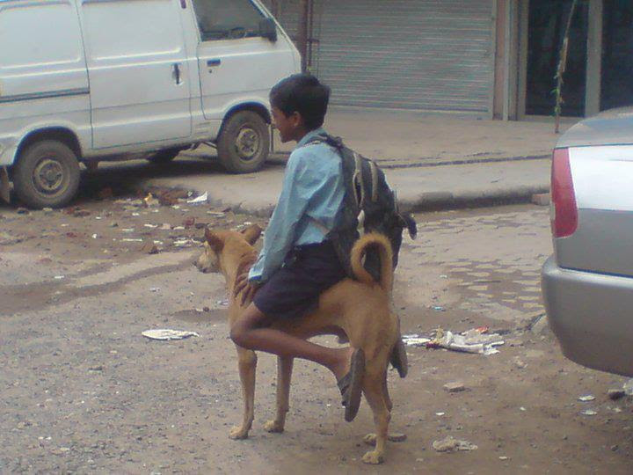
We lead our lives from those dog knowledgewe learned..
Notes:
And, We lead our lives from those dog knowledgewe learned..

Slide 21
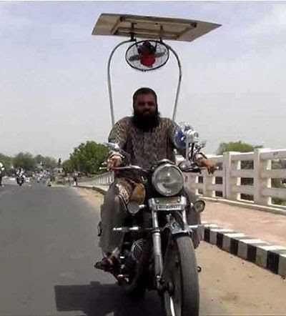
The only purpose is to live this life comfortably.
No A/C?
Let me do something!
Notes:
The bottom line of our goal is:
Exploit as much to make ourselves happy, comfortable.

Slide 22
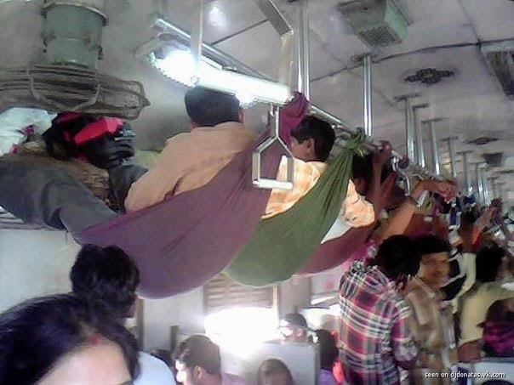
The whole aim of material education is to live ourselves comfortably
Notes:
That is the only aim of our education here.
Nothing else. No spiritual value.

Slide 23
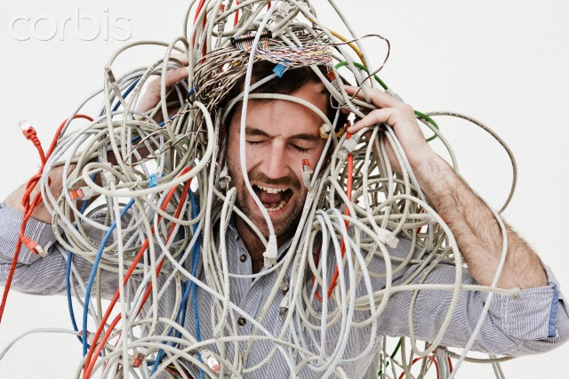
And, more the material knowledge,.. more will be the entanglement
Notes:
But, more the material knowledge,.. more will be the entanglement
If I have 2 computers, I have double problems,
If I have 10 computers, I have plenty of problems.
If you have no wife, you have no problem!
But if you have 2 wives, you have problems and problems !!!

Slide 24
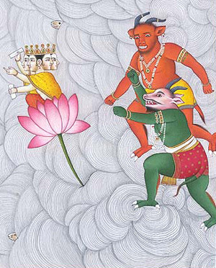
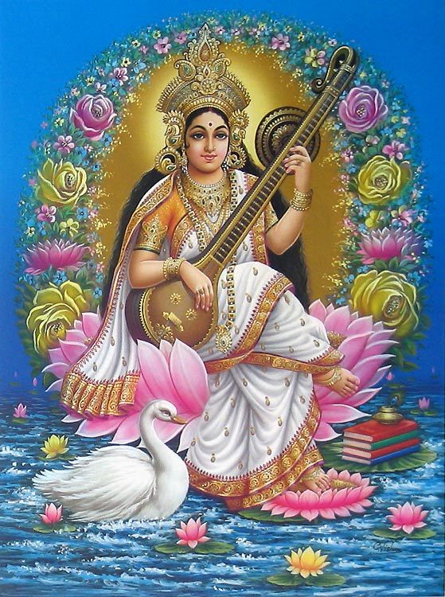
What else does the material Knowledge bring?
Pride & EGO !
They are like Daemons.
Sad Varga..
Kama – Lust
Anger – Angry if Lust not satisfied
Lobha - Greed to get more
Moha – Loss of intelligence
Mada – Pride
Maatsarya - Envy
Notes:
Even Lord Brahma went thru this..
Brahma Vimohana!!
He got PRIDE..!!

Slide 25
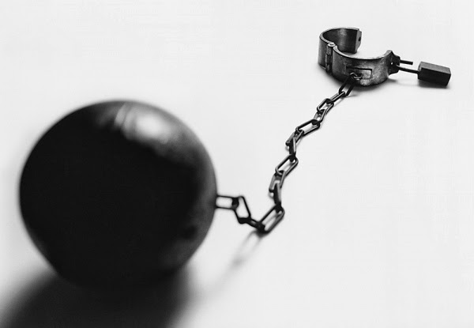
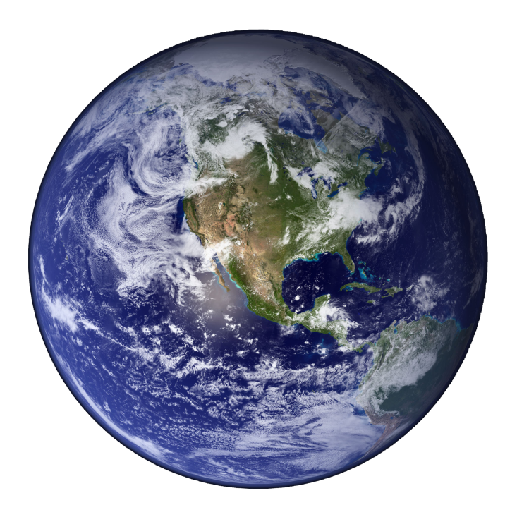
But Spiritual Knowledge unbinds you!
It breaks the shackle and gives you mukti
Notes:
The spiritual knowledge unbinds you!
Breaks the shackle!
No more birth and death.

Slide 26
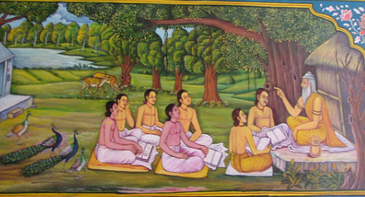
In DESCENDING process, we give our FULL faith..
Notes:
But that knowledge has to come from above to down to us..
It is about something that we CANNOT see..
Examples: Jiva, God, Higher Worlds, Dimensions, and so on..
Our great great Rishis were not ordinary people.
They have seen and realized and written down for us and teach us.
Why? To save us..
Because, when one gets this Spiritual Jnana, we get liberated.

Slide 27
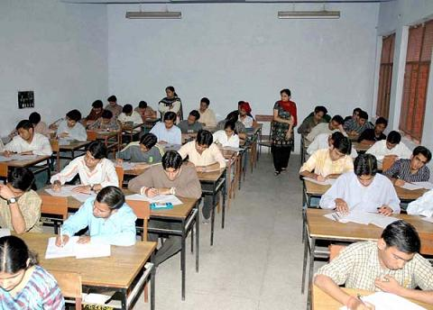
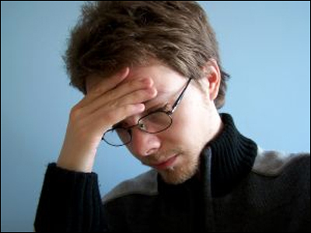
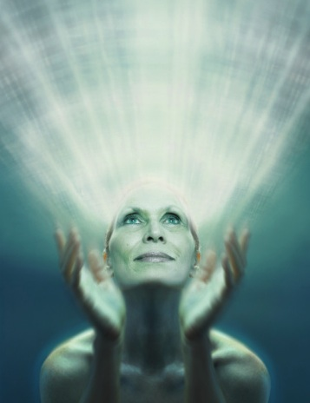
TEACHER:
First TEACHES, and
Then TESTS
LIFE:
First comes the TEST, and
we LEARN from that !
Notes:
But knowledge comes to us different ways..
Teacher teaches and THEN gives us the test
But Life gives us the test and then we learn!

Slide 28
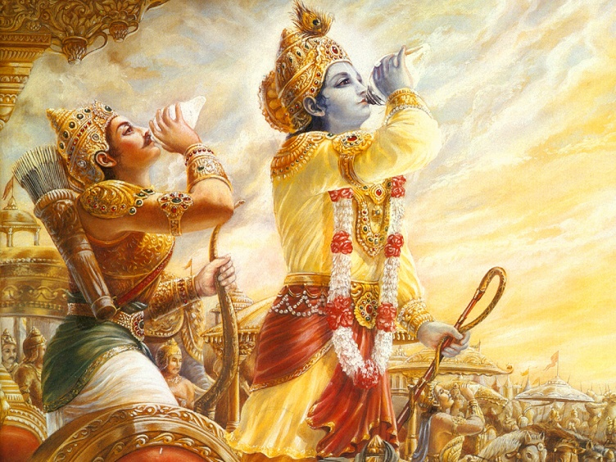
What is Jnana?
To know :
Isvara (Lord Sri Krsna) *,
Jiva (the spirit soul),
Prakriti (nature),
Kala (time) and
Karma
What is Divine Knowledge?
It is the one knowing which EVERYTHING is known..
That is to know about Bhagavan Sri Krsna!
But, who can know Krishna?
* - Only partial understanding possible
Notes:
Now, what is Jnana?
These are the 5 topics in Bhagavad Gita
Each one is actually an ocean..
What we can understand from material birth is very negligible..
Different lokas of higher worlds reveal more knowledge.

Slide 29
Jnana
Kala
Prakrti
Isvara
Jiva
Karma
Vidya
Notes:
Want some student to take this and explain as a Presentation..!
KRISHNA is full of KNOWLEDGE.
No one is higher than KRISHNA.

Slide 30
Namo vijńāna rupāya
Paramānanda rūpiņe
Krşņāya gopināthāya
Govindāya namo namah
(Gopala Tapani Upanishad 1.37)
Sat, Cid, Ananda are His attributes..
On the fly sloka!!!! (repeat from last program)
Notes:
** last time we memorized.. It was from our Cache ***
** But this time, we are going to pull from our LONG TERM Memory bank **
Bhagavan is Sac Cid Ananda..
He is full of knowledge – Vijnana – Vidya !

Slide 31
What is the result of attaining Jnana – even without bhakti?
Your Karmic reactions are burnt!
Your entanglements are cut
You will not be born again in any material worlds
You will attain Brahman (not Bhagavan!)..
Notes:
Karma Yoga may not liberate you..
But Jnana Yoga will liberate you..

Slide 32
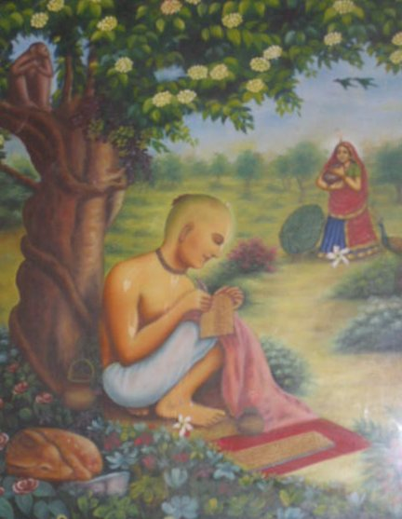
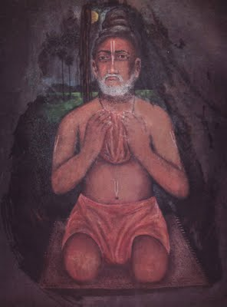
But Vidya gives all the understanding about Bhagavan.
This also leads to PURE BHAKTI..
Notes:
Just DRY Jnana cannot give Bhagavan..

Slide 33
Material Knowledge
VIDYA
Acuired by Experiments
Acquired via Devotees
Mostly Ascending
Always Descending
Makes one proud
Makes one humble
Deceived by our senses
Illuminating, Suddha Cid
Ends in depression
Ever increasing JOY
Temporary
Permanent & Eternal

Slide 34
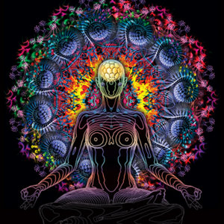
Jnanis (without Bhakti) will merge into Brahman!
<- “See Mom!
I can become Nothing!
Isn’t it Cool?”
Mom: “Shut up stupid!”
Our acharyas have mentioned this as ‘Spiritual Suicide’
Notes:
And become nothing!

Slide 35
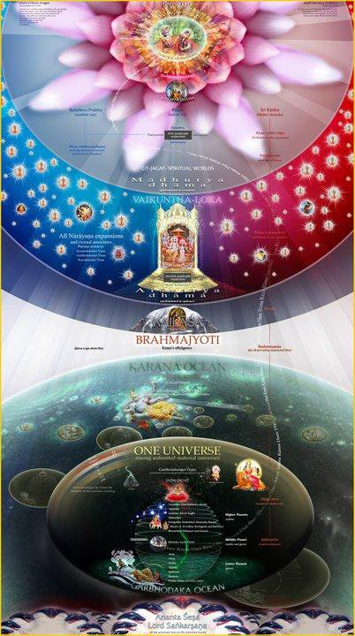
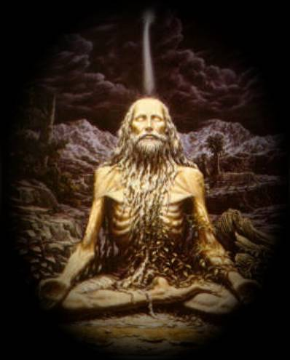
The highest destination for such Jnanis and Yogis is BRAHMAN
Notes:
Karmis go to Heavenly Planets..(for Good Karma)
Yogis want to go to Yogi’s planets upto Satya Loka.
Upto this is actually the territory of Durga Devi.
For a Jnani, the BRAHMAN is the final destination.

Slide 36
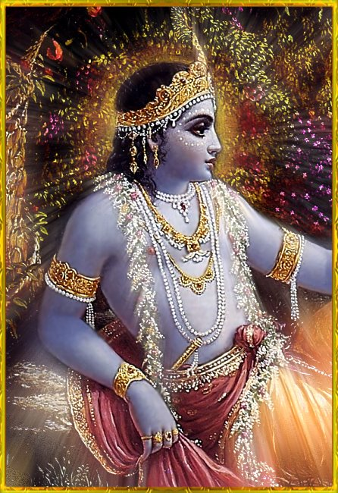
Jnana can’t reach Krsna, but Bhakti can
…
Vedeşu durlabham,
adurlabham ātma bhaktau
Govindam ādi purusham
Tam aham bhajāmi
… (B.S 5.33.2)

Slide 37
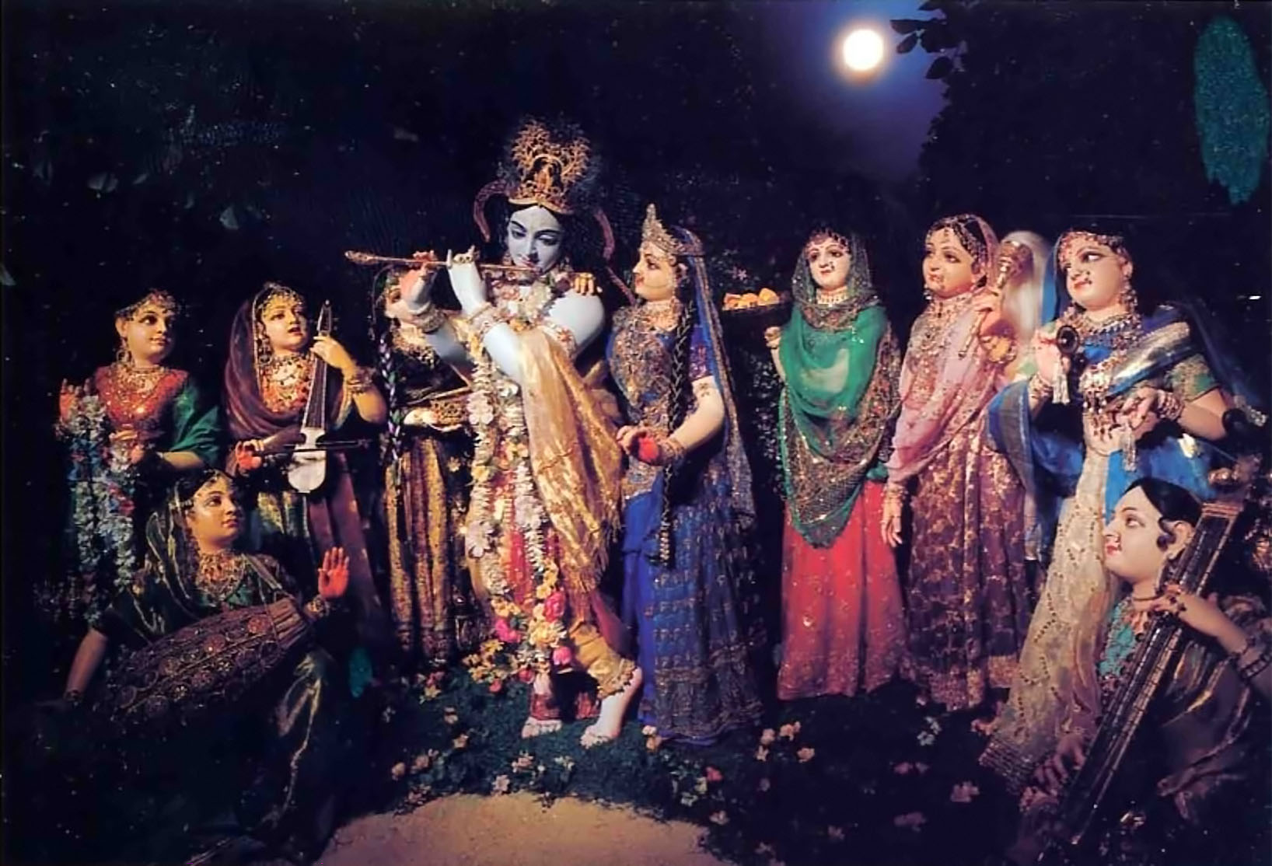
So, the only way to attain Sri Krishna is by Devotion - BHAKTI. There is no other way.
Notes:
To go to Brahman, there may be many ways, the different paths..
But to go to Bhagavan, there is ONLY ONE way!

Slide 38
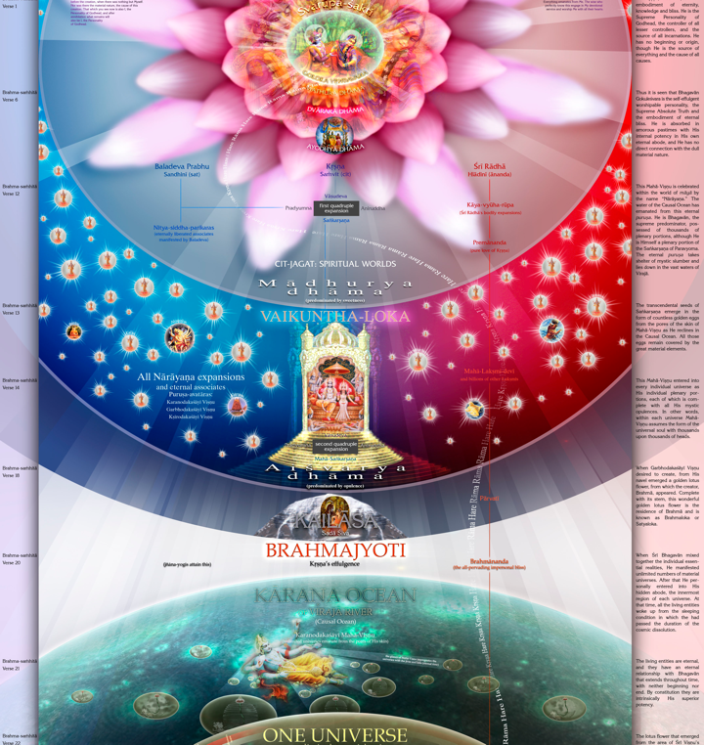
How do we know?
It is in so many scriptures.
There are two divine energies covering the Knowledge..

Slide 39
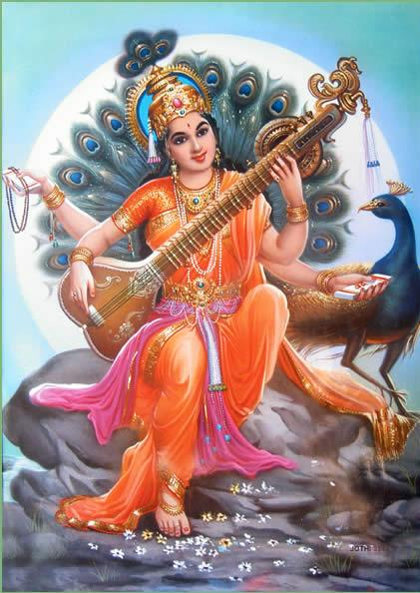
Vidya
&
Saraswati
are different..
From Vidya comes unlimited Saraswatis
Vidya is purely spiritual..
Knowledge: Vidya, and Saraswati..
Notes:
One is original..
Vidya is seen with Peacock..
Saraswati can make you Pride!
In the life of Caitanya, a pundit from Kashmir came to debate.
He was none other than Brhaspati, the guru of all Gods and Lord Indra.
He was blessed with the power from Saraswati.
He failed miserably with Caitanya as a small boy!
Saraswati appeared to the pundit and explained who Nimai was.

Slide 40
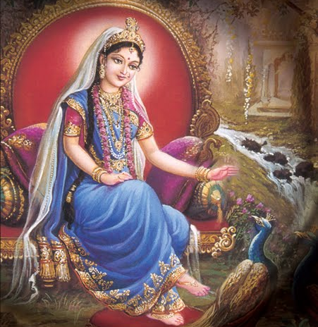
Vidya always makes one humble, not like Saraswati..
Notes:
No scripture or even ANY sampradaya knows about Srimati Radha Rani..
Divya Saraswati (Vidya) came from the tip of the tongue of Srimati Radha Rani..
She is mentioned in the very first sloka of Shikshashtka.
From Vidya comes unlimited manifestations of Saraswati to supply knowledge for Brahma.
Brahma gets Pride.. Why? Because he has Saraswati..

Slide 41
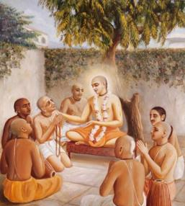
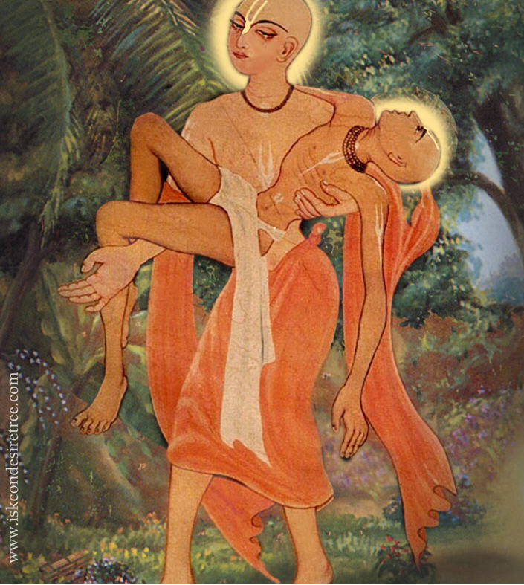
Notes:
Vidya gives Humbleness.
When Lord Brahma came as Srila Haridasa Thakur, he was the most humble.
He was Lord Brahma the higest and grand grand father of every living being.
Because he got Vidya (not saraswati) here, he was very humble.
He will sit only outside the houses.
He received the remnants ONLY after EVERYONE else eats first.
Why? (ref: Brahma Vimohana.. )

Slide 42
Most of the Bhakti we know are Mixed (Misra Bhakti)
Pure Bhakti
(Unconditional & Ananya)
Goal?
Jnana Misra Bhakti
(Chaya Bhakti, Goal: Mukti)
Karma Misra Bhakti
(Chaya Bhakti,
Goal: Heavenly Enjoyment)
Adharma Bhakti
(Lowest,
Goal: Comfortable Life)
Notes:
In the world, we see only the reflection of Bhakti.
Adharma Bhakti, Karma Misra Bhakti, Jnana Misra Bhakti are all Chaya Bhaktis – NOT real.
Pure Bhakti cannot be understood by any.
It requires mercy from pure devotee.
Only Lord Caitanya can give that – no one else!
No other forms of Krishna also can give that!

Slide 43
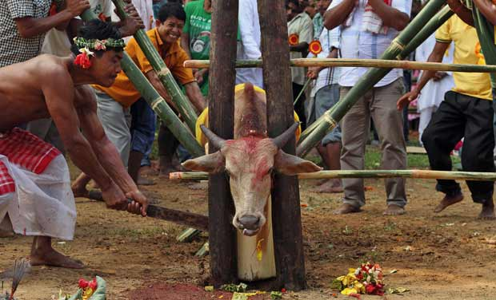
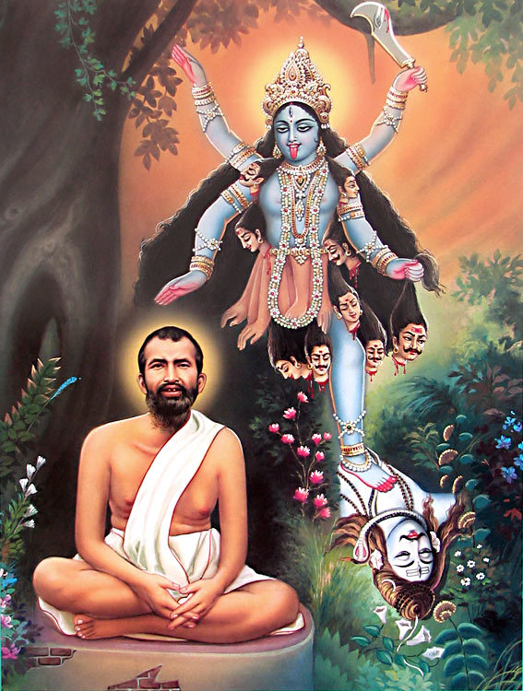
Adharma Bhakti
(Lowest,
Goal: Comfortable Life)
Notes:
This is the lowest of all..
Most of the Hindus who commits Violence (Himsa) fall into this category.
In fact, this is the majority of Hinduism as right now.
They may even preach nicely, but all bogus.

Slide 44
Karma Misra Bhakti
(Chaya Bhakti,
Goal: Heavenly Enjoyment)
Notes:
Modern day Christianity lies in this category..
One god thing is that they have Ananya Bhakti.
Thus, they are way better than Hindus.
Most of the sampradays of Sanatan Dharma also belong to this category..
They may have ananya bhakti, but the goal is different.
They all want mukti and they get Mukti.

Slide 45
Jnana Misra Bhakti
(Chaya Bhakti, Goal: Mukti)
Notes:
Jnana as such is useless as they cannot reach Bhagavan.
When they develop any bhakti to Bhagavan, they get opportunity to turn from their path.
Otherwise they become DRY Jnanis – Sunya Vadis, and they merge in Brahman.

Slide 46
Pure Bhakti
(Unconditional & Ananya)
Notes:
Pure Bhakti is Unconditional – very difficult to undrstand for all
Pure Bhakti is Ananya – Single pointed - Only one Sadhya – Krsna as the ultimate and NO ONE ELSE.
This can come only by mercy of Guru and Gauranga..

Slide 47
1. Gross Self Enjoyment in Heaven
3. Divine bliss in making Krishna happy..
2. Spiritual Death in Brahman
Notes:
So, in summary:
Dharmis want punya and thus enjoy in Heaven – but is temporary
Karma Yogis want to enjoy in much higher worlds
Jnanis want to merge in Brahman – which is nothing but the effulgence of Krishna

Slide 48
Notes:
But those who do not want any of those, but ONLY KRISHNA, are the Crown jewel.
Are they many?
Let us see what Bhagavan says…..

Slide 49
Dharmacari madhye bahuta karma nistha
Koti karma nistha madhye eka jnani srestha
Koti- jnani-madhye haya eka-jana mukta
Koti-mukta-madhye durlabha eka Krsna-bhakta ...... (C.C. Madhya 19.147-148)
[ Among the followers of Vedic dharma, most of them follow the process of karma (fruitive activity) distinguishing pious and impious activities. Out of millions of such people, there may be one who is actually wise (jnani). Out of many millions of such wise persons, only one may actually become liberated (mukta), and out of many millions of such liberated persons, a pure devotee of Lord Krsna is very rarely found.]
Notes:
Of millions of Dharmis, one may be a Karma Yogi
Of millions of such Yogis, one may be a Jnani
Of millions of such Jnanis, one may be a Mukhta
Of millions of Muktas, it is extremely difficult to find a Krishna Bhakta!
So, every one else has only mixed Bhakti – Chaya Bhakti. They cannot reach Krishna!

Slide 50
SB-17
na pārameṣṭhyaḿ na mahendra-dhiṣṇyaḿ
na sārvabhaumaḿ na rasādhipatyam
na yoga-siddhīr apunar-bhavaḿ vā
mayy arpitātmecchati mad vinānyat
(S.B. 11.14.14)
One who has fixed his consciousness on Me desires neither the position or abode of Lord Brahmā or Lord Indra, nor an empire on the earth, nor sovereignty in the lower planetary systems, nor the eightfold perfection of yoga, nor liberation from birth and death. Such a person desires Me alone.
Notes:
A pure bhakta does not want any power.
They don’t want to practice Karma Yoga or Jnana Yoga.
They don’t want to be a demi god.
They don’t want to be a Indra.. The god of all the gods.
[In fact, once Krsna showed an ANT to Brahma and said that it was an Indra before!!]
They don’t want to be a Brahma.
They don’t want anything except Krishna!

Slide 51
Those Bhaktas are always in the heart of Krishna!
Sadhavo hrdayam mahyam
Sadhunam hrdayam tv aham
Mad-anyat te na jananti
Naham tebhyo manag api ........(S.B. 9.4.68)
[ Lord Krsna says, �My pure devotee is always within the core of My heart, and I am always in his heart. My devotee does not know anything else but Me, and I do not recognize anyone else as mine.�]
Notes:
And Krishna says that for Him, there is no one else in His heart except His pure devotees.
Krishna is very special!

Slide 52
E-57
Giridhara Baalam Gopaalam
Govinda Raamam Keshavam
Komazha Kaantam Arbhudam
Krishnam Vande Jagat Padam ..(Giri)
Murali Manohara Sundaram
Mukundaa O' Madhu Sudhanam
Vrindaa Vanapura Vaasanam
Krishnam Vande Jagat Padam ..(Giri)
Gokula Manjuzhaa Manmatham
Govindaa Adi Shobhanam
Gopika Lolam Mangalam
Krishnam Vande Jagat Padam ..(Giri)
Vishamaya Kaazhiya Nartanam
Krishnaa O' Nanda Nandanam
Vishama Kesi Martanam
Krishnam Vande Jagat Padam ..(Giri)

Slide 53
Skipped the Great Pastime of Radha Rani and Sri Krishna related to this topic..

Slide 54
D-57
Rādhikaa Krishna Rādhika
Tava virahe keshava
Sarasam-srnnamapi malayaja pankam
Pasyati vishhameva vapusshisa sankham
Svasita pavanam anupama parinaham
Madana dahanam iva vahati sadā aham
Disi disi tirati sajala kanālam
Nayana nalinam iva vigalita nālam ..(Radhika)
Nayana vishhayam api kisalaya talpam
Gannayati vihita hutāsa vikalpam
Tyajati na pānni talena kapolam
Bāla sasinam iva sāyam alolam ..(Radhika)

Slide 55
Hare Krishna!
Thank You!
End of Episode
Notes:
Ceto Darpana ..
Vidya vadhu Jeevanam..
You aspire for Vidya – Not Saraswati for Material Knowledge

Slide 56
Duty of every Gokul Kid…
Take bath in the morning
Chant one round of Maha Mantra in Puja Room
Sing a short Sloka
Be a strict Vegetarian
Offer Bhoga and also take it as lunch to school
In the School, do your best you can
When back from School, finish Homework same day
At night sing a bhajan in Puja Room
You will be a Joyous Gokul Kid.!!!

